Slide 1
AP2 WH Lab Power Supply Regulator Improvement
Change from Superior voltage regulators ---
to Chroma Power Supplies

Slide 2
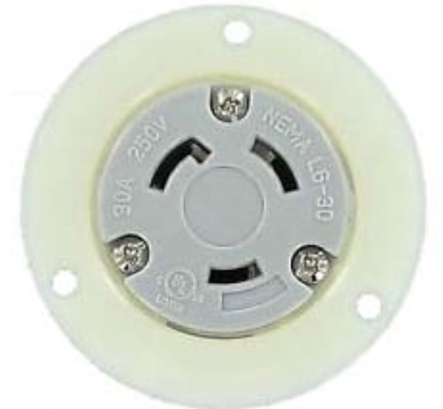
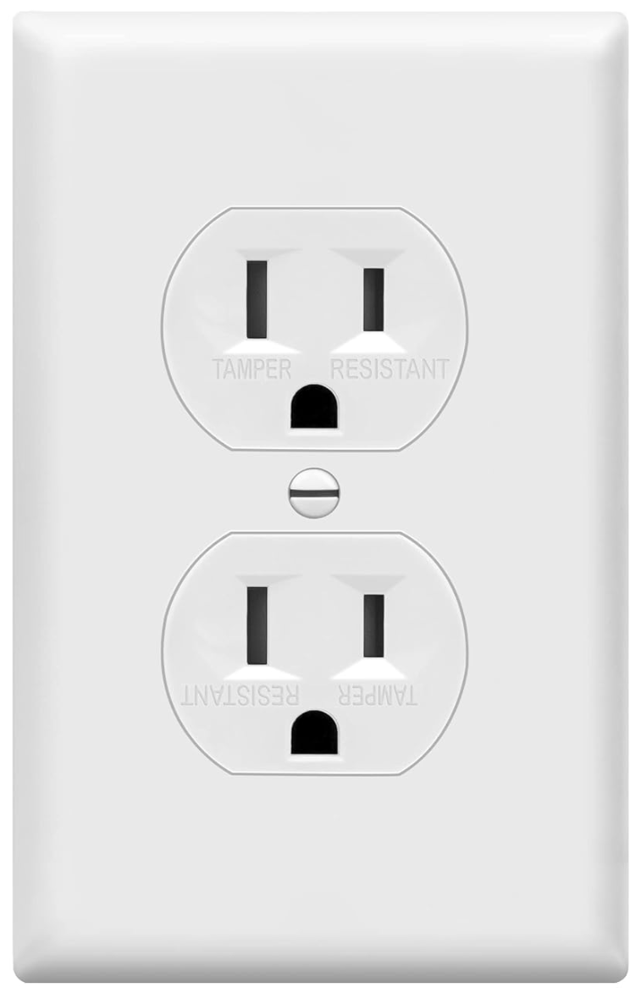
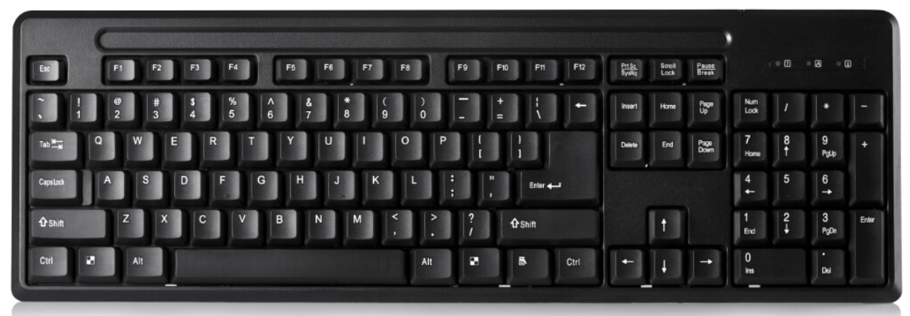
Chamber Wall Outlets
IN
OUT
DAQ - WT310E
Power Analyzer
Choma Power
Supply
Current
Voltage
G
L1
L1
480V 3PH
Drop
L2
L1
(120v-G) L1
+
-
+
-
L2
L2
Coil
240V
L3
(120v-G,180°)L2
Station A
L3
(120v-G) L3
Relay
N
N
N1
240 (L2)
G
G
N2
N
L1
N3
120 (N)
G
G
120V
Duplicate Wiring
G
L1
WH Test SW
Select unit voltage:
◦ 120V
• 240V
L2
240V
Stations B and D will be supported by a 2nd Chroma Power Supply
(Mirror image to what is shown here)
(4) Chroma Power supplies needed:
Chamber 5 (2), and Chamber 8 (2)
Station C
120V

Slide 3
